Slide 1
The Global Risks Report 2016
  Caroline Galvan
  Luxembourg, 27.04.2016

Slide 2
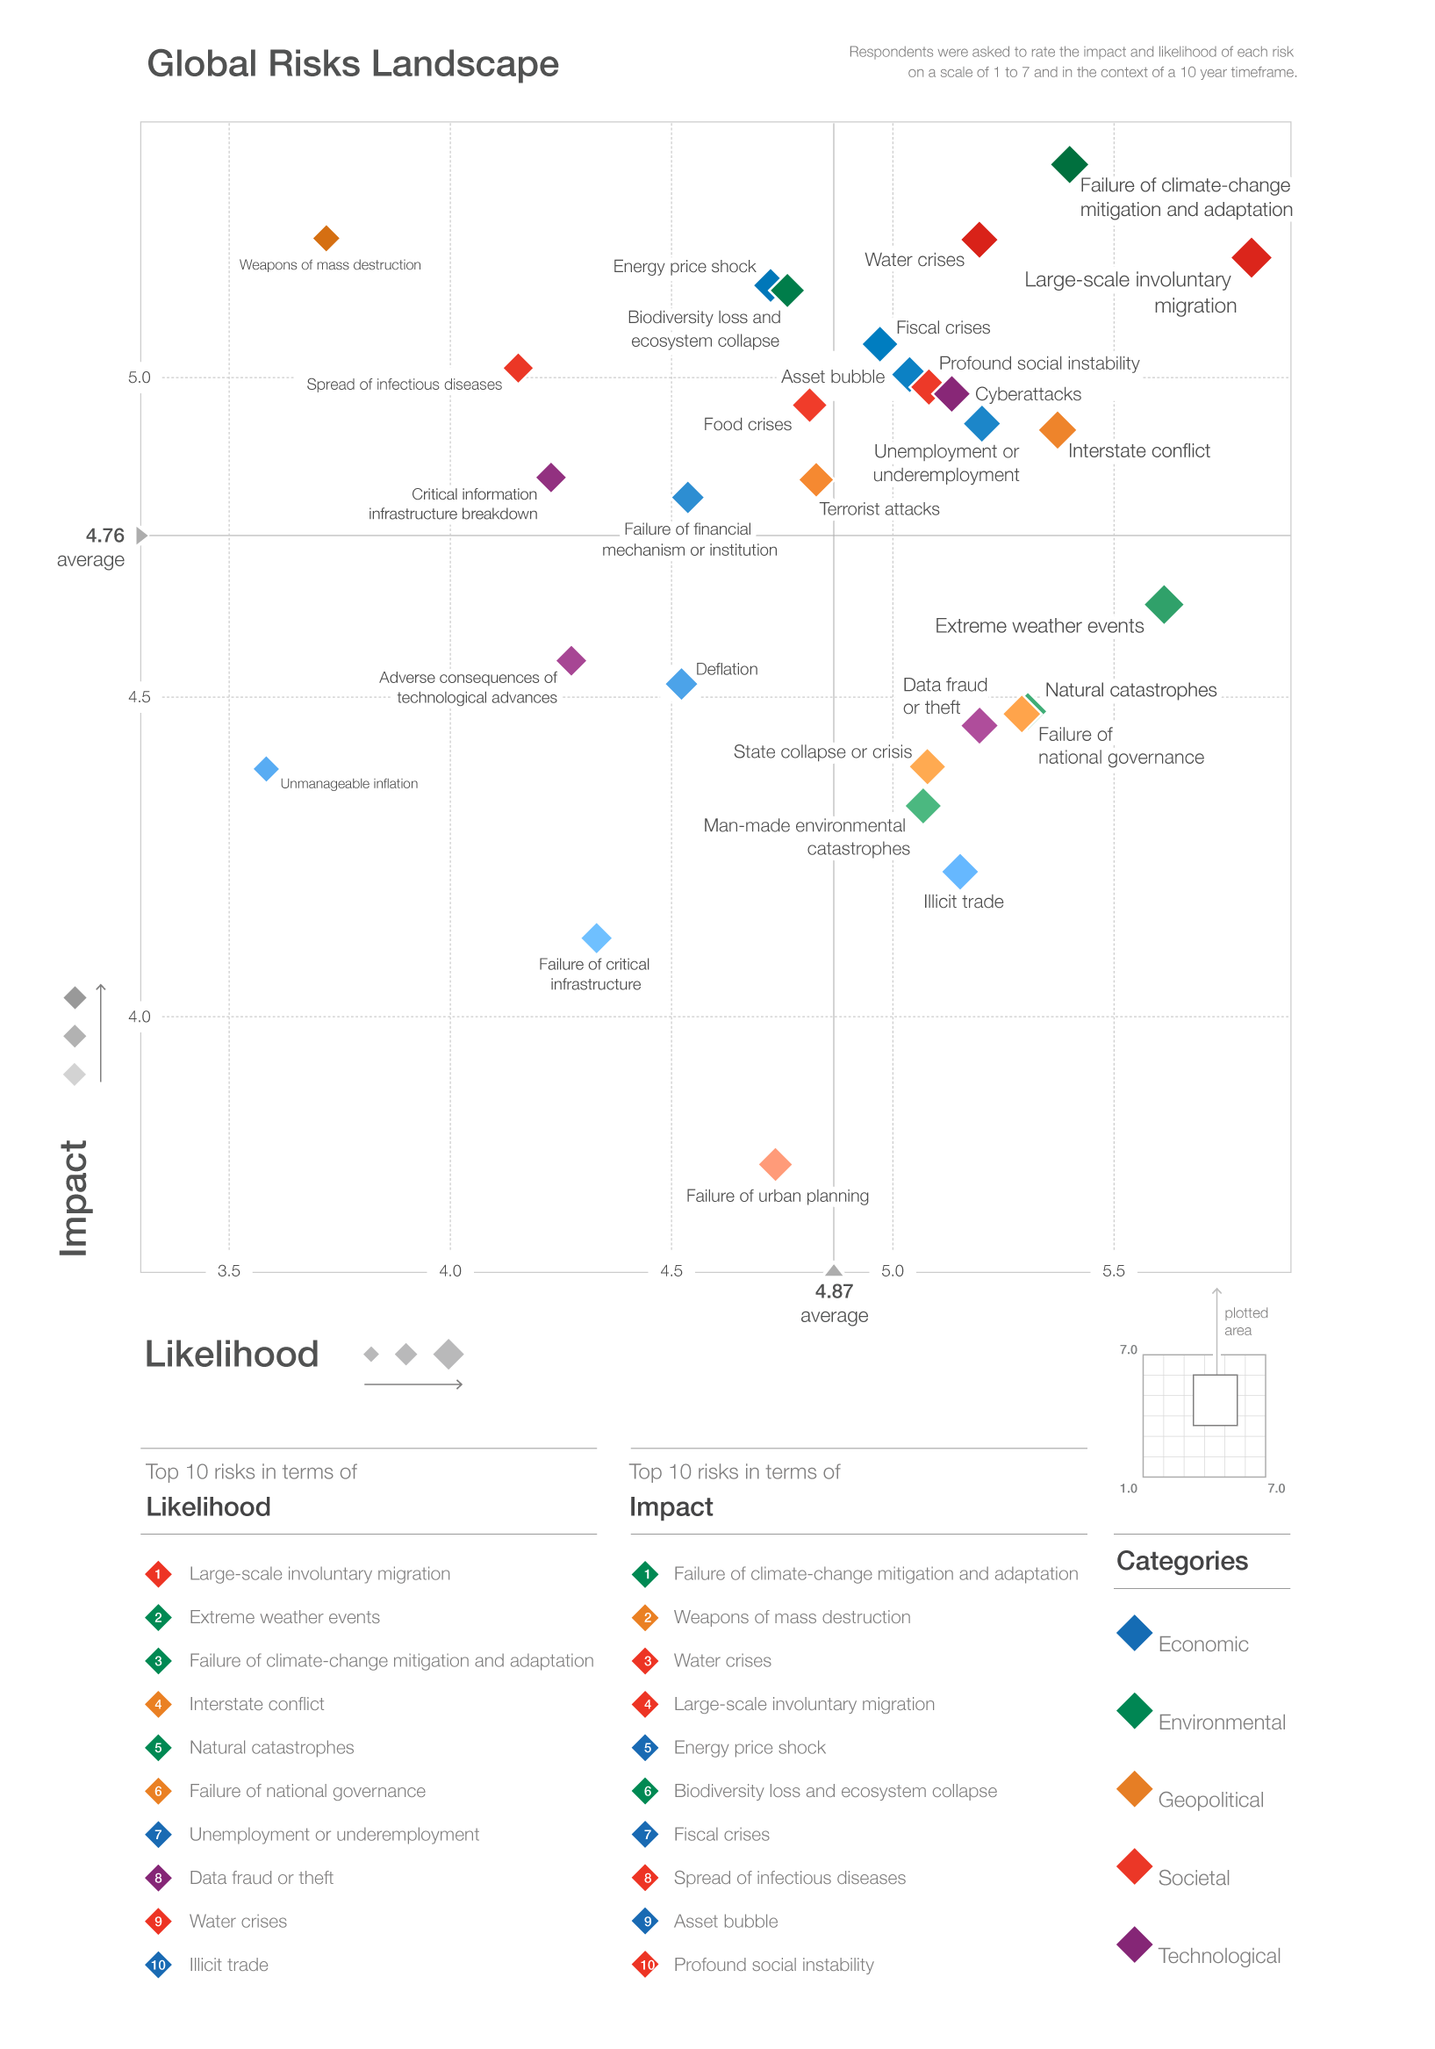

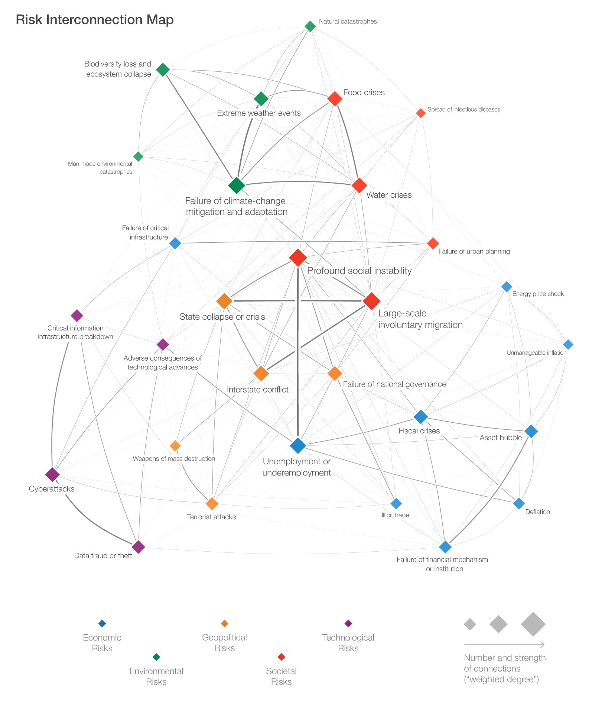
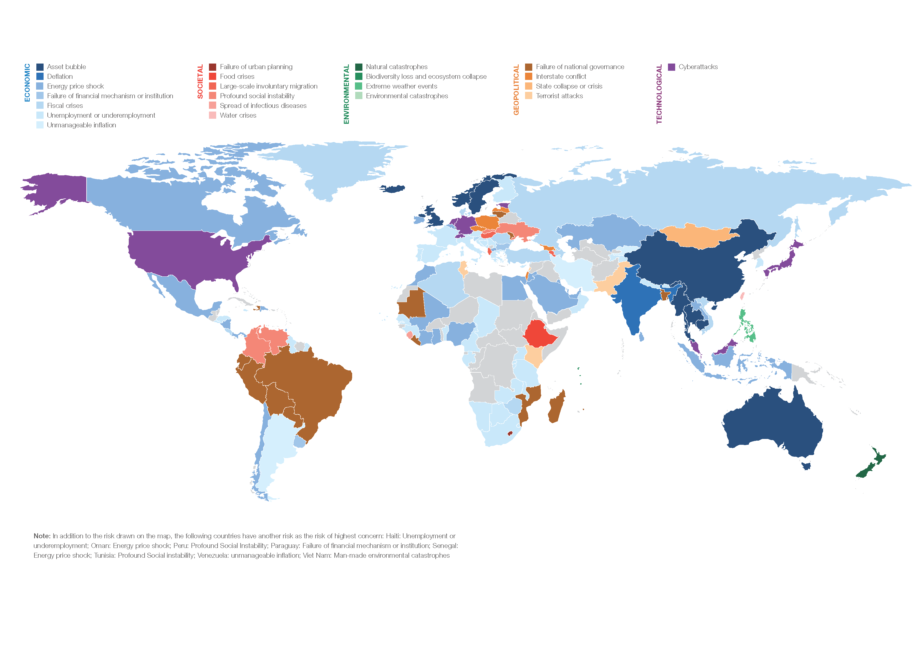
The Global Risks Report 2016
Four parts covering risks
01
  The Global Risks Perception Survey
02
The Security Outlook 2030
03
  Risks in Focus
04
  Risks for Doing Business at a Glance

Slide 3
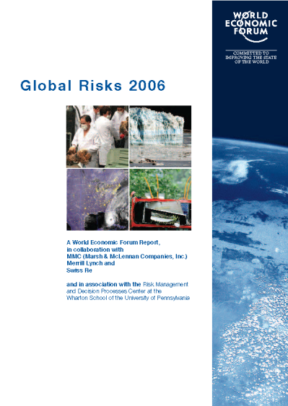
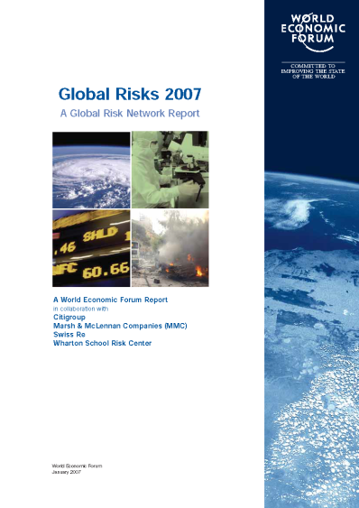
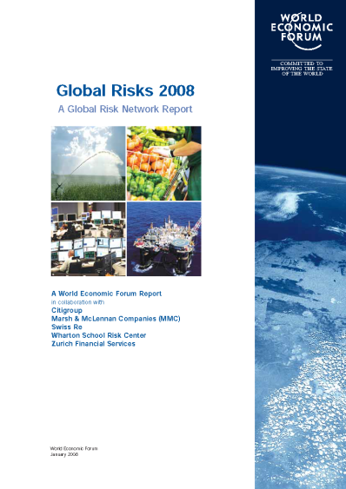
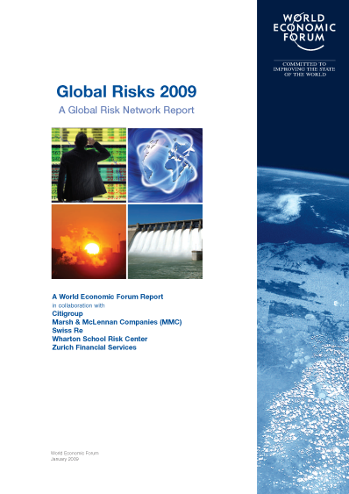
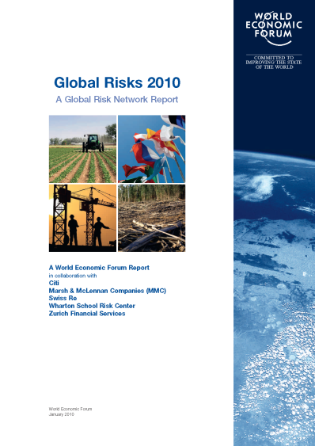
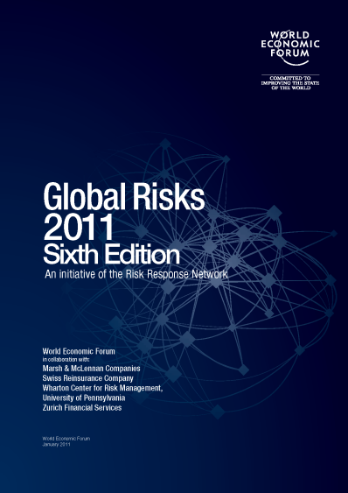
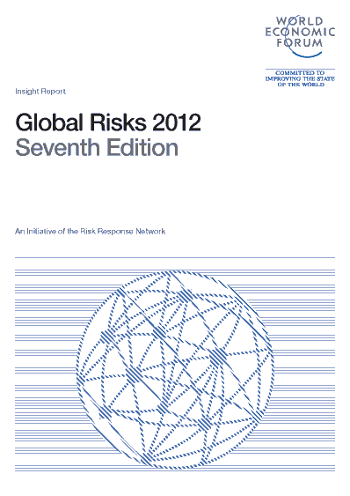
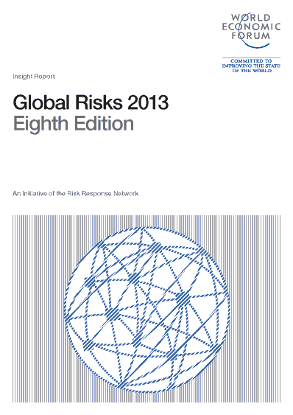
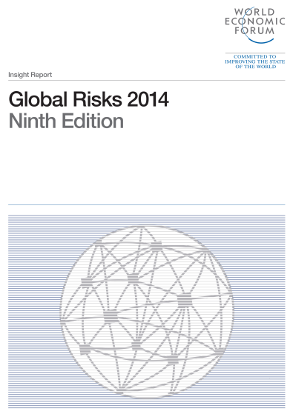
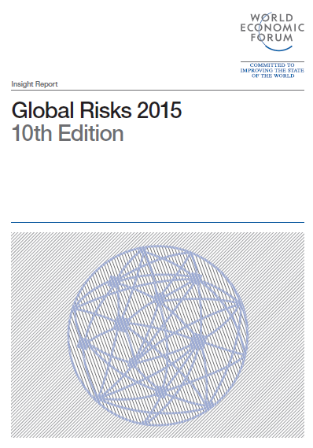
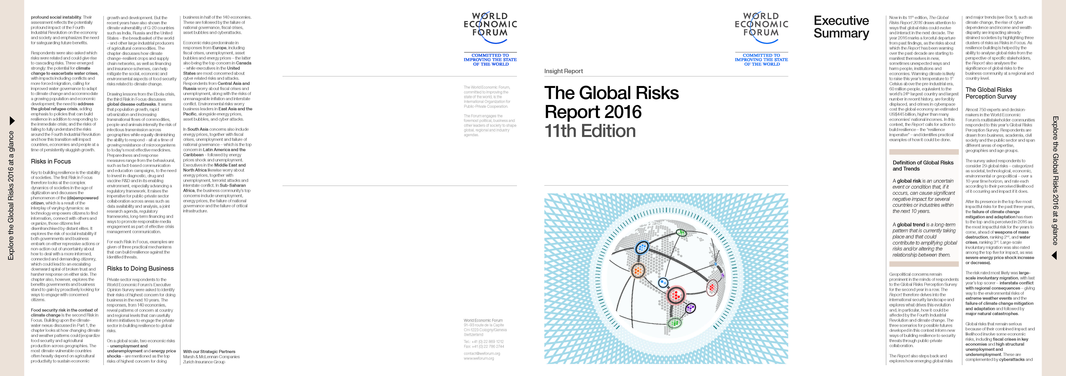
The Global Risks Report 2016
Governance structure
Now in its 11th edition, the Global Risks Report annually highlights the most significant long-term global risks, drawing on the perspectives of almost 750 experts and decision-makers.
This latest edition has an increased focus from risk identification to risk anticipation and mitigation to resilience.
The Global Risks Report 2016 report is produced in collaboration with Strategic Partners of the World Economic Forum:
Marsh & McLennan Companies
Zurich Insurance Group
Academic Advisers to the report are:
National University of Singapore
Oxford Martin School, University of Oxford
Wharton Risk Management and Decision Processes Center, University of Pennsylvania
And the Advisory Board of the Global Risks Report 2016

Slide 4
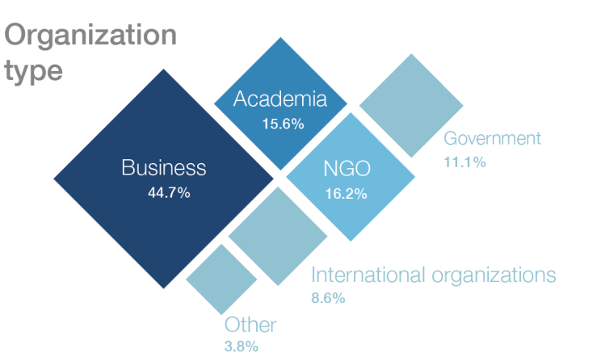
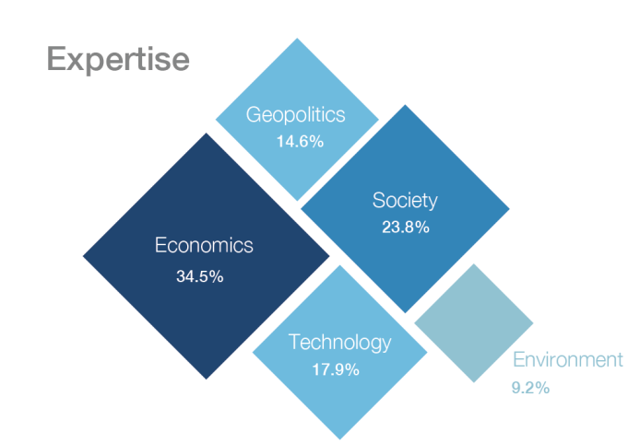
The Global Risks Report 2016
Methodology of the Global Risks Report and Survey
The Global Risks Perception Survey captures the perceptions of 742 experts and decision-makers in the World Economic Forum’s multistakeholder communities on global risks, trends and their evolution.
29 Global Risks
“…an uncertain event or condition that, if it occurs, can cause significant negative impact for several countries or industries within the next 10 years.”
Economic
9
Environmental
5
Geopolitical
5
Societal
6
Technological
4
13 Global Trends
“…a long-term pattern that is currently taking place and that could contribute to amplifying global risks and/or altering the relationship between them.”

Slide 5









The Global Risks Report 2016
The Global Risks Landscape 2016

Slide 6
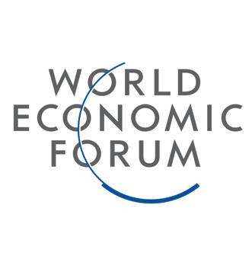

Slide 7
The Global Risks Report 2016
In recent years, societal, geopolitical and environmental risks have taken primacy over economic risks
Climate change +
water supply crises
Interstate conflict
Economic
Pandemics
Chronic disease
Environmental
2007
2008
2009
2010
2011
2012
2013
2014
2015
2016
1
Geopolitical
By impact
5
Societal
Technological
Asset price collapse
Major financial
system failure
Fiscal crises
Oil price shock + Retrenchment
from globalization
Note: This depiction assigns constant categories to some risks which have changed categories over the report’s eleven editions

Slide 8
The Global Risks Report 2016
The Global Risks Interconnections Map 2016
  Societies continue to be under pressure
  (most interconnected risks)
  Profound social instability and unemployment or underemployment most interconnected risks pair

Slide 9
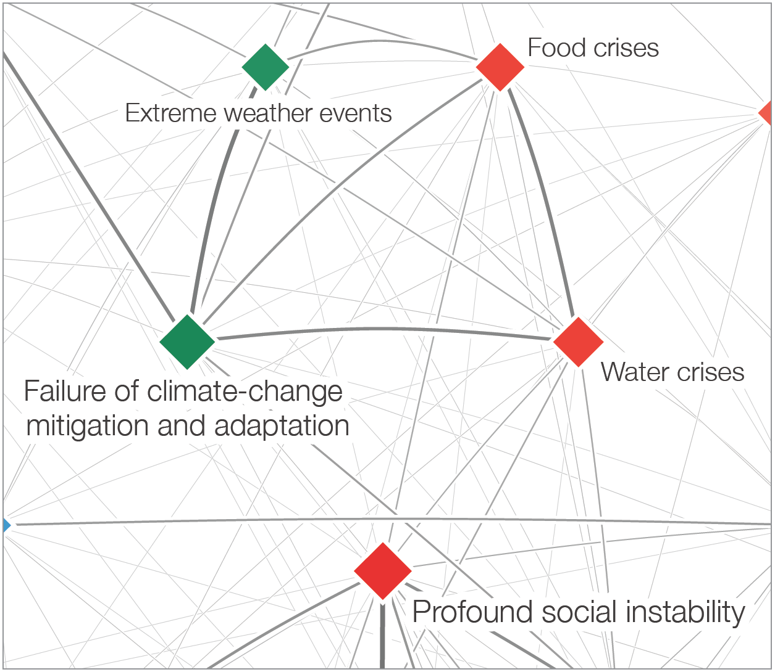


The Global Risks Report 2016
Coping with a changing climate
  The potential for climate change to exacerbate water crises with impacts including conflicts and more forced migration, calling for improved water governance.

Slide 10
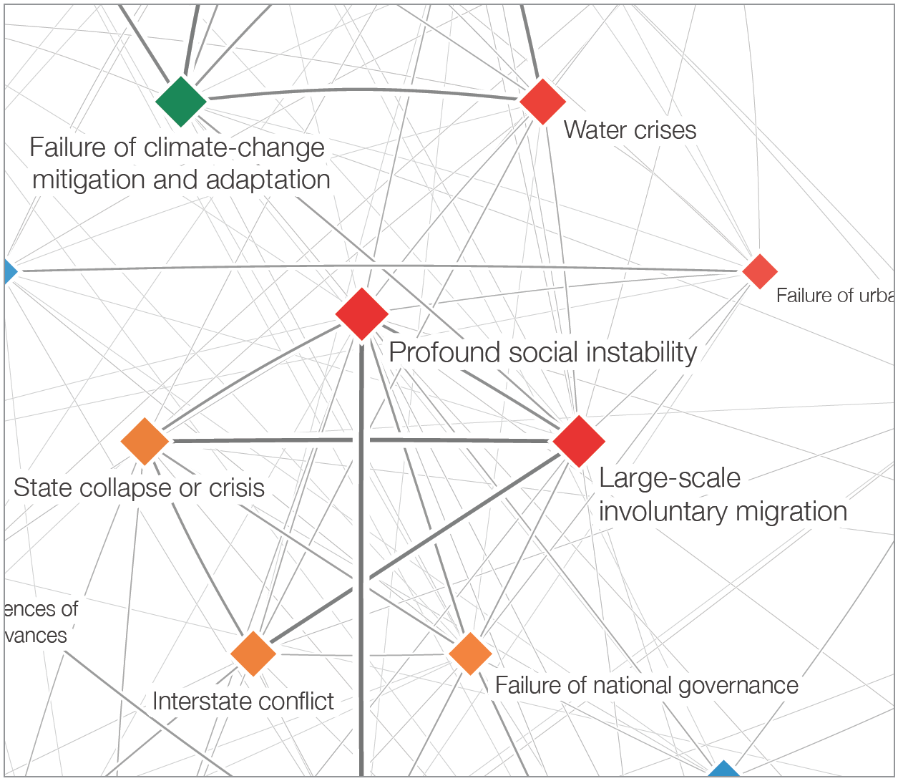


The Global Risks Report 2016
Humanity on the Move
  There is an urgent need to address the global refugee crisis, adding emphasis to policies that can build resilience in addition to responding to the immediate crisis.

Slide 11

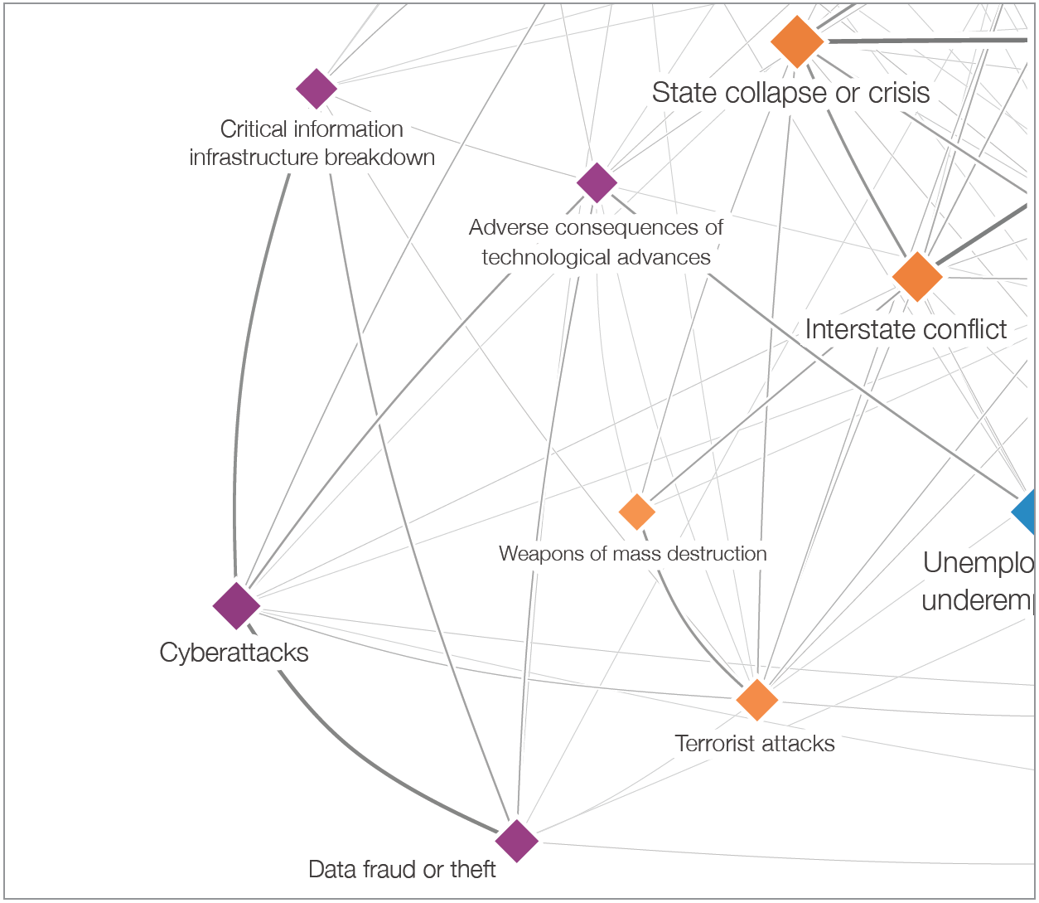


The Global Risks Report 2016
Economic Growth 4.0
  The risks of failing to fully understand the risks of the Fourth Industrial Revolution and how this transition will impact countries, economies and people at a time of persistently sluggish growth.

Slide 12
The Security Outlook 2030

Slide 13
Part 2 examines the security outlook over the next 15 years
The security landscape is in flux, threatening the last 25 years’ social, economic and political progress
Technology, social fragmentation and demographics combine to create new threats
Two main phenomena:
  the vacuum from weak states allow space for significant non-state actors
  a return of strategic competition from strong states
Multi-polar becomes multi-layered: pressure both between and within
Chronic and resurgent violence, conflicts and socio-economic volatility will remain prominent
Notes:
“International security” refers to the measures taken by state or non-state actors, individually or collectively, to ensure their survival and integrity against transboundary threats.

Slide 14

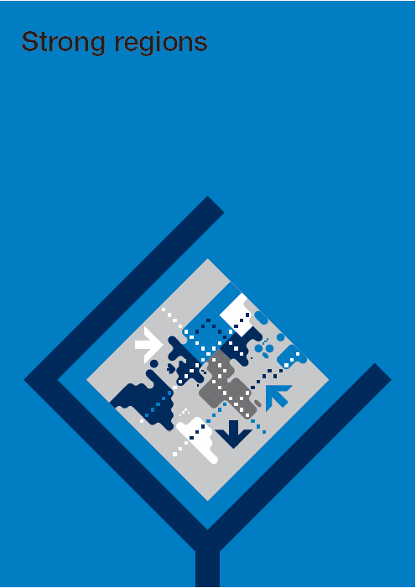

… and explores three plausible trajectories in a rapidly and radically changing international security landscape

Slide 15
Risks in Focus: Society

Slide 16
The report highlights three broad-based risks that may affect global development over the coming decade
1
(Dis)Empowered Citizen
The phenomenon of the (dis)empowered citizen, is a result of the interplay of technology empowering citizens to find information, connect with others and organize, while at the same time those citizens feel disenfranchised by distant elites.
2
Climate Change and Risks to Food Security
Changing climate and weather patterns could jeopardize food security and agricultural production across geographies. Especially in already fragile societies this will fuel social instability.
3
Global Disease Outbreaks
Population growth, rapid urbanization and transnational commodity flows, intensify the risk of infectious transmission across geographies while equally diminishing the ability to respond – all at a time of growing resistance of microorganisms to today’s most effective medicines.

Slide 17
Risks for Doing Business at a Glance

Slide 18
The Global Risks Report 2016
Global Risk of Highest Concern for Doing Business

Slide 19
Global Risk of Highest Concern for Doing Business
Failure of national governance

Slide 20
Global Risk of Highest Concern for Doing Business
Cyberattacks

Slide 21
Global Risk of Highest Concern for Doing Business
Asset bubble

Slide 22
Executives in Europe are overwhelmingly concerned by economic challenges
Top risks for doing business by country
Top 5 risks for Europe
Economic
1
Unemployment or underemployment
Fiscal crises
Failure of financial mechanism or institution
Energy price shock
Asset bubble
2
Environmental
3
4
Geopolitical
5
Societal
Top 5 risks for Luxembourg
1
Asset bubble
Failure of financial mechanism or institution
Unemployment or underemployment
Fiscal crises
Cyber attacks
Technological
2
3
4
5
Source: World Economic Forum, Global Risks Report 2016

Slide 23
The Global Risks Report 2016
The Resilience Imperative
The year 2015 is estimated to be warmest on record –
global average surface temperature 1° Celsius above the pre-industrial era
Close to 60 million people are on the move (refugees and internally displaced)
Cybercrime estimated to have cost the global economy over US$450 billion in 2014– close to the GDP of Switzerland
As risks are becoming more imminent and increasingly felt by societies, institutions, and economies, there is an urgent need to advance resilience.
Societies
Institutions
Business

Slide 24
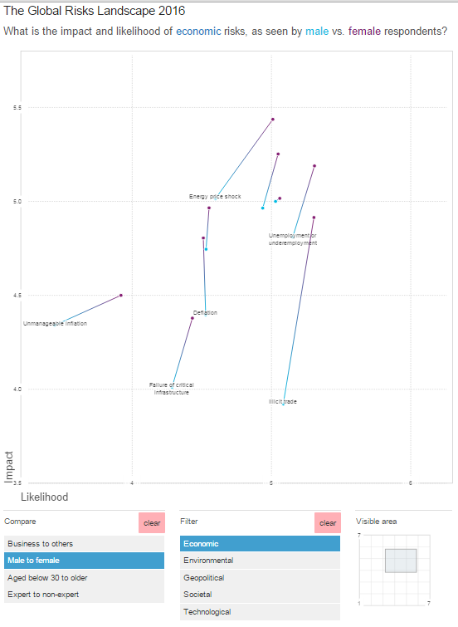
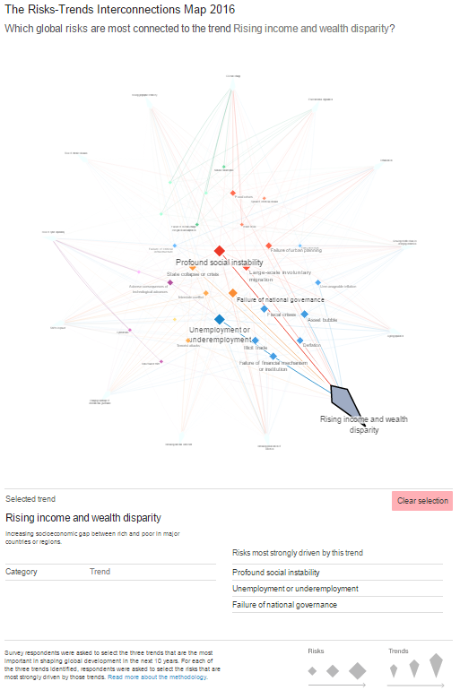
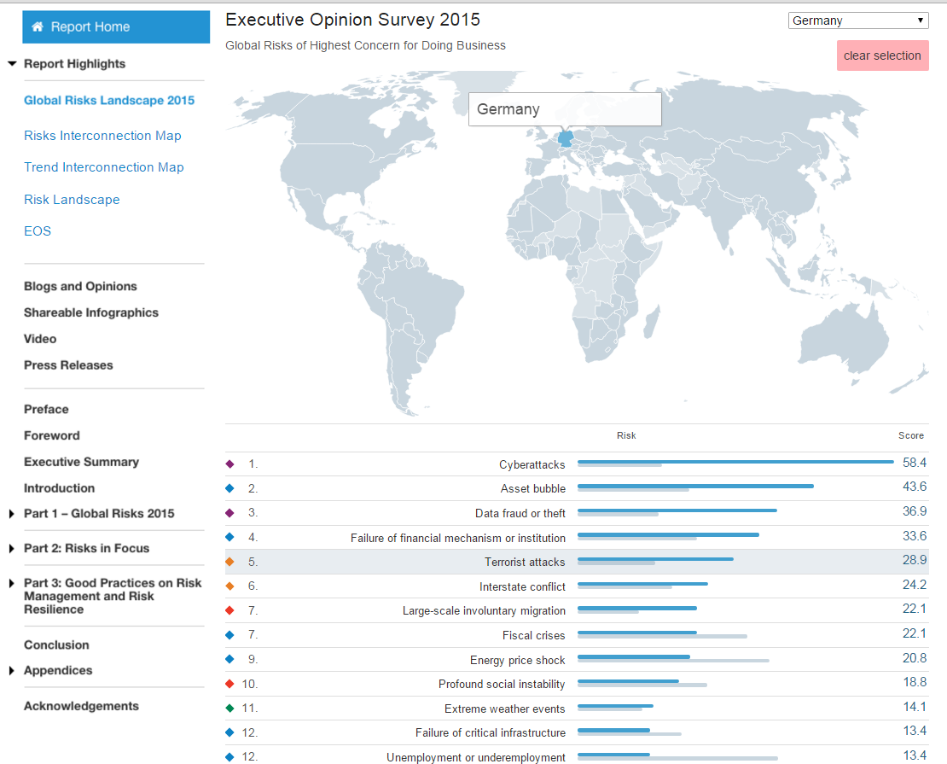
The Global Risks Report 2016
Interactive tools
Please go online http://wef.ch/risks2016 to explore the data

Slide 25
Thank you for your attention

